Slide 1
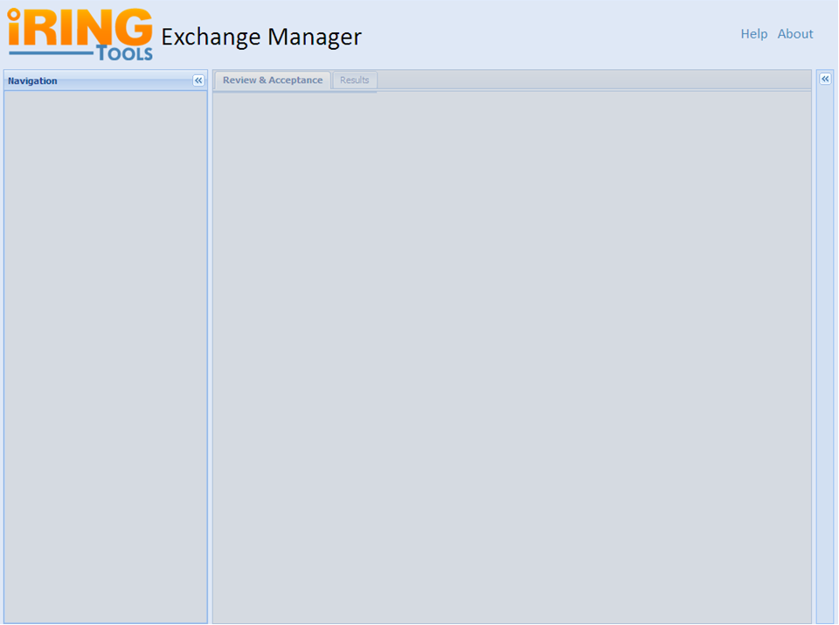
IRINGTOOLS-8: Basic Layout
Notes:
Sub Tasks:
Package ExchangeManager for Deployment.
Deploy ExchangeManager Package and Verify on Test Server.

Slide 2


IRINGTOOLS-1: About Screen
Version 2.00.00.128
The Exchange Manager is a tool for viewing, filtering and exchanging data between applications. The tool provides generic review & acceptance functionality for exchanging data between iRINGTools Services endpoints.
Copyright (c) 2009, 2010, iringug.org All rights reserved.
Redistribution and use in source and binary forms, with or without modification, are permitted provided that the following conditions are met:
Redistributions of source code must retain the above copyright notice, this list of conditions and the following disclaimer.
Redistributions in binary form must reproduce the above copyright notice, this list of conditions and the following disclaimer in the documentation and/or other materials provided with the distribution.
Neither the name of iringug.org nor the names of its contributors may be used to endorse or promote products derived from this software without specific prior written permission.
THIS SOFTWARE IS PROVIDED BY THE COPYRIGHT HOLDERS AND CONTRIBUTORS "AS IS" AND ANY EXPRESS OR IMPLIED WARRANTIES, INCLUDING, BUT NOT LIMITED TO, THE IMPLIED WARRANTIES OF MERCHANTABILITY AND FITNESS FOR A PARTICULAR PURPOSE ARE DISCLAIMED. IN NO EVENT SHALL THE COPYRIGHT OWNER OR CONTRIBUTORS BE LIABLE FOR ANY DIRECT, INDIRECT, INCIDENTAL, SPECIAL, EXEMPLARY, OR CONSEQUENTIAL DAMAGES (INCLUDING, BUT NOT LIMITED TO, PROCUREMENT OF SUBSTITUTE GOODS OR SERVICES; LOSS OF USE, DATA, OR PROFITS; OR BUSINESS INTERRUPTION) HOWEVER CAUSED AND ON ANY THEORY OF LIABILITY, WHETHER IN CONTRACT, STRICT LIABILITY, OR TORT (INCLUDING NEGLIGENCE OR OTHERWISE) ARISING IN ANY WAY OUT OF THE USE OF THIS SOFTWARE, EVEN IF ADVISED OF THE POSSIBILITY OF SUCH DAMAGE.
Close
Notes:
Links:
WSO2: http://wso2.com/products/enterprise-service-bus/ (would rather not)
BSD3: http://www.opensource.org/licenses/bsd-license.php
iRINGUG: http://iringug.org/wiki/index.php?title=ExchangeManager
Help Link will goto: http://iringug.org/wiki/index.php?title=ESBUsersGuide

Slide 3
IRINGTOOLS-6: Directory Resource
ESBServices will provide a Directory Resource. This will temporarily be used by the EM, but later will be called through the ESB.
Example Base Uri (will be configurable in PHP): http://localhost:8080/iringtools/directoryservice
Relative Uri: /directory
Method: GET
Notes:
Sub Tasks:
Adjust exsiting prototype Directory class per team discussion.
Package ESBServices for Deployment.
Deploy ESBServices Package and Verify on Test Server.
Sample Directory XML:
http://iring-tools.googlecode.com/svn/trunk/iRINGTools.ESB/documents/directory.xml

Slide 4
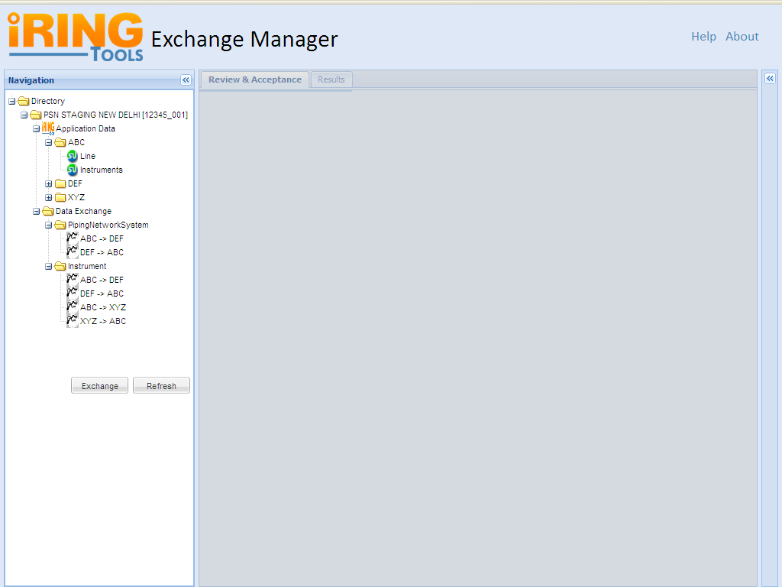
IRINGTOOLS-14: Directory Panel
Default View for a Project
Notes:
Directory Panel
This Panel will show a tree view of all Application Data and Data Exchanges coming under each Project Scope.
Sub Tasks :
1.. Handling the Request and Response of Web Services
2.. Marshaling for XML to JSON conversion
3.. Generate Tree View and display in Navigation Panel
4.. Events Handling
4.1 Display Dialog box on double click on nodes under Data Exchange.
4.2 Click on Exchange Button
4.3 Click on Refresh Button
4.4 Enabling and Disabling panels on different events
5.. Unit Testing
6.. Deploy and Verify on Test Server
Default view of this Page:
- Navigation Panel expanded with Directory Listing Collapsed
- Disabled Center Panel with tabs: Review & Acceptance & Results
- Property Grid Collapsed
Assumptions: Exchange Manager Knows All the Project Scopes & the Navigation Panel is responsible for display of all Applications & their exchanges.
To get the details of these Exchanges we will consume the web service from the PHP Application. After getting the XML Response we will use PHP to generate the View.
Sample Directory XML:
http://iring-tools.googlecode.com/svn/trunk/iRINGTools.ESB/documents/directory.xml

Slide 5
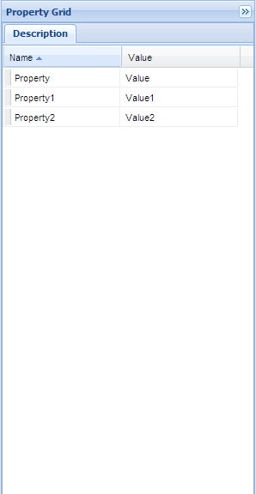
IRINGTOOLS-15: Details Panel
As soon as clicked on exchange the grid will updated
User Clicks on an Exchange
Notes:
Property Grid Panel
This Grid Panel will populated with corresponding data as soon as a user clicks on the exchange name on Navigation Panel.
The Directory.xml will be used to get the details(Property & Value) of each node.
Sub Tasks :
1. Binding with Directory Tree
2. Marshaling for XML to JSON conversion
3. Generate Grid View

Slide 6
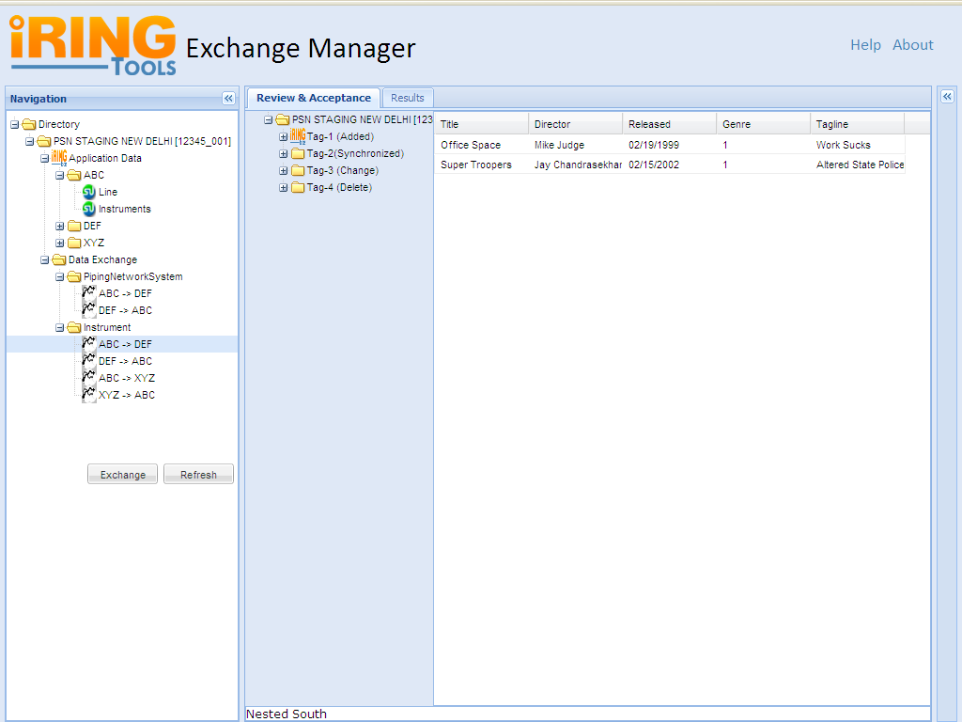
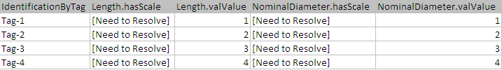
IRINGTOOLS-17: Data Grid Tabbed Panel
Notes:
Data Grid Panel
This Panel will show a tree view of all identifiers, properties and values of a selected Data Exchange. Identifiers will be displayed in Tree View and their properties/values in Grid View form.
Sub Tasks:
- Handling web services Request & Response for DTI as well as DXO
- For Tree Marshaling XML to JSON conversion
- Display Tree Panel of Identifiers
- Pagination on Tree Panel
- Marshaling XML to JSON conversion for Grid View
- Display Grid View of properties and their values
- Binding Tree with the Grid View
- Implement caching mechanism
- Transfer or send data to destination application
- Unit Testing
- Deploy and Verify on test server
Default view of this Page:
- Navigation Panel expanded
- Expanded Review & Acceptance Tree Panel along with 1st 20 identifiers list
- Paging at the bottom of Tree
- Expanded Review & Acceptance Grid Panel along with the list of properties of first tag
- Property Grid Collapsed
Assumptions: Exchange Manager Knows the exchangeID whose DTI info to be fetched from the web service.
First the Web Service will respond the DTI info and our Exchange Manager App will convert into appropriate format so that it can send another Web service request to get the DTO information of these set of identifiers. We have all information related to the 1st set of identifiers with us and we will able to generate the Tree & Pagination.

Slide 7
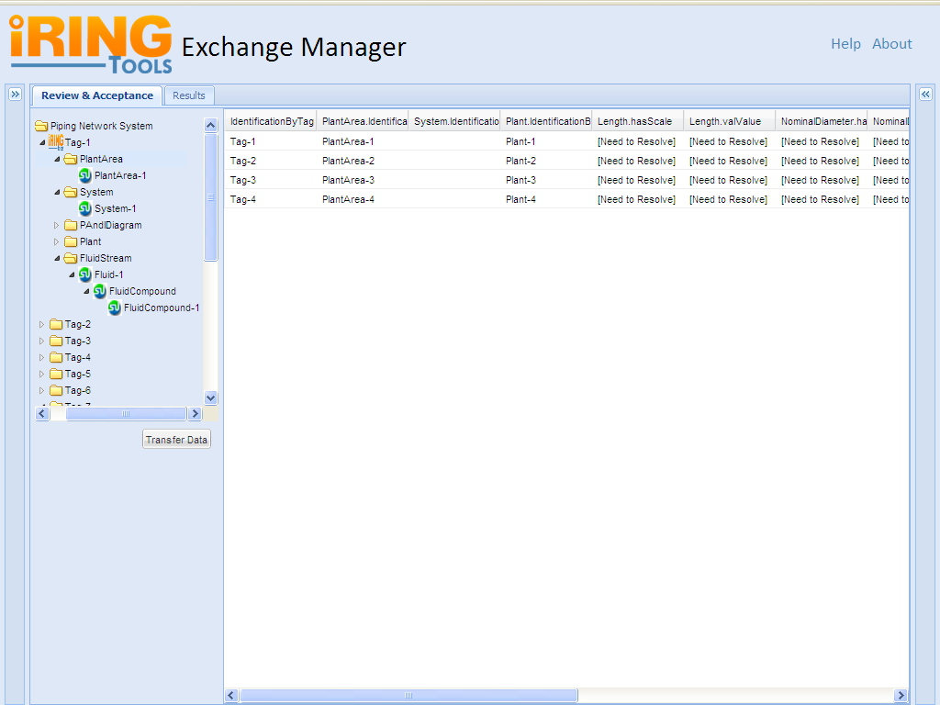
IRINGTOOLS-18 : Related Item Navigation
As soon as the user will select the nodes the corresponding property for that node will be populated within a grid view
Notes:
Default view:
- Review & Acceptance Tree Listing would be in form of expanded as first level
(Display only Identifier Tags i.e. Tag-1, Tag-2)
- Paging on the bottom of the Tree.
Functionality :
- Display Tree with the combination of DTO and DTI
- A User can traverse the tree to know about properties or values associated with each identifier.
- On Click a Identifier node can be expand upto three level.
- The Grid View would be populated on click of any Tree Node.

Slide 8
IRINGTOOLS-27: DataTranferIndices Resource
ESBServices will temporarily provide a DataTransferIndices Resource.
@path params: scope, exchangeid.
Example Base Uri: http://localhost:8080/iringtools/directoryservice
Relative Uri: /{scope}/exchanges/{exchangeid}/index
Method: GET

Slide 9
IRINGTOOLS-28: DataTransferObject Resources
ESBServices will temporarily provide a DataTransferObject resource.
@path params: scope, exchangeID
@request params: DTI (subset or entire DTI)
Example Base Uri: http://localhost:8080/iringtools/diffservice
Relative Uri: /{scope}/exchanges/{exchangeID}
Method: POST

Slide 10
IRINGTOOLS-29: DataTranferIndices Differencing
ESBServices will provide a RESTful service to difference two DataTransferIndices.
@path params: N/A.
@request params: sourceDTI, targetDTI
Example Base Uri: http://localhost:8080/iringtools/differencingservice
Relative Uri: /indices
Method: GET

Slide 11
IRINGTOOLS-30: DataTranferObject Differencing
ESBServices will provide a RESTful service to difference two DataTransferObjects.
@path params: N/A.
@request params: sourceDTO, targetDTO
Example Base Uri: http://localhost:8080/iringtools/differencingservice
Relative Uri: /objects
Method: POST

Slide 12
IRINGTOOLS-31: Exchange Submittal
ESBServices will temporarily provide a RESTful service to submit an exchange.
@path params:scope, exchangeId
@request params:DTI and cached DTO
Example Base Uri: http://localhost:8080/iringtools/diffservice
Relative Uri: /{scope}/exchanges/{exchangeID}/submit
Method: POST

Slide 13
Submit an Exchange from DataGrid Panel
As soon as the user will select the nodes the corresponding property for that node will be populated within a grid view
User wants to Transfer the Data after Review & Acceptance

Slide 14
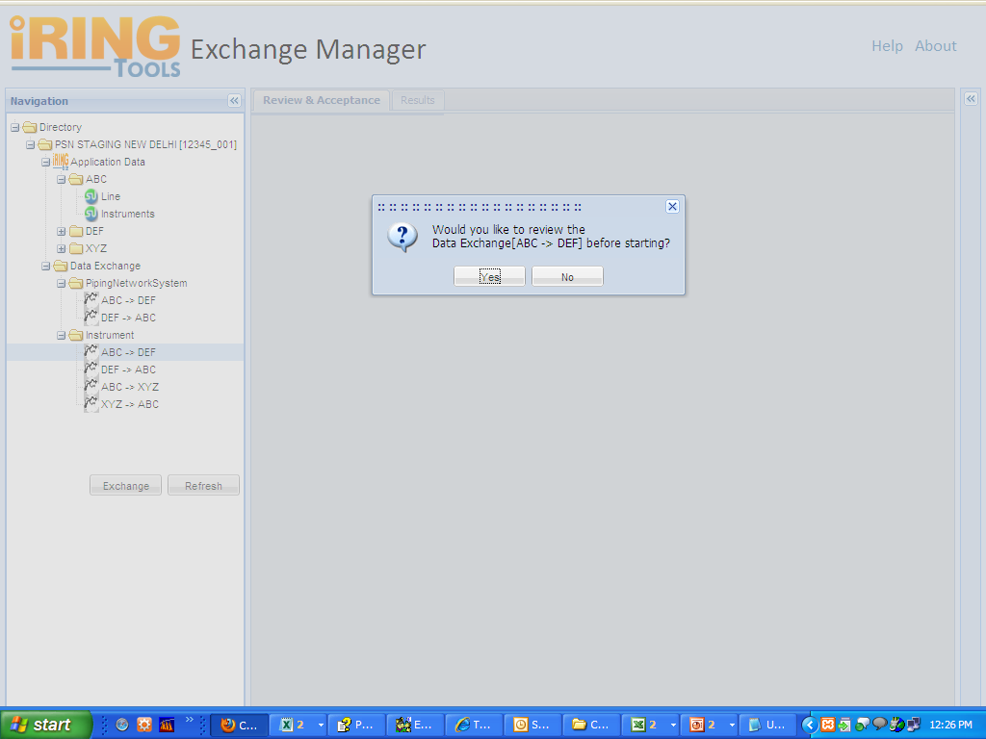
IRINGTOOLS-16: Submit an Exchange From the Directory Panel
User double clicked on an Exchange Name like ABC >> DEF
User Clicked on Yes
Notes:
Task Title : Event Handling
Sub Tasks:
- Display Dialog box on double click on nodes under Data Exchange.
- Click on Exchange Button
- Click on Refresh Button
- Enabling and Disabling panels on different events
Functionalities of Dialog Box:
- Ask for Review before Exchange with options Yes/No
- In case of "Yes" : Under Review & Acceptance Tab Tree and Grid will be generated
- In case of "No" : Data will transfer from the Source >> Destination application directly and display the Status Under Result Tab

Slide 15
IRINGTOOLS-33: Exchange History Resource
ESBServices will provide an ExchangeHistory resource.
@path params:scope, exchangeId
Example Base Uri: http://localhost:8080/iringtools/diffservice
Relative Uri: /{scope}/exchanges/{exchangeID}/history
Method: GET

Slide 16
IRINGTOOLS-34: Exchange History Panel
8:00 AM 10/22/2010 IAMERS\rpdecarl
Exchange Submitted
…
Exchange Completed Successfully.
7:30 AM 10/22/2010 IAMERS\rpdecarl
7:15 AM 10/22/2010 IAMERS\rpdecarl

